Slide 1



Accounting for Demographic Differentials in Forensic Error Rate Assessment of Latent Prints via Covariate-Specific ROC Regression
CVIP 2020
Fifth IAPR International Conference on Computer Vision & Image Processing (CVIP2020)
Paper ID: 221
Emanuela Marasc, Mengling He, Larry Tang, and Sumanth Sriram
Sumanth Sriram; Mengling He

Slide 2
Outline
CVIP 2020
Introduction
Motivation
Problem Statement
Experimental Setup
Covariate-specific ROC curve Method
Model results
Conclusion
Acknowledgement

Slide 3
Introduction
CVIP 2020
Automated tools might introduce bias has gained a lot of interest in the recent days.
Unfairness in machine learning outcomes arise from biases in the data as well as from the algorithms.
If these biases are not interpreted and solved, algorithms might reinforce societal discrimination and injustices.
Although ROC curve has been essential for assessing classification performance, the presence of covariates can affect the discriminatory capacity.
Hence systematic research is needed to understand, explain and minimize the biases that can compromise the invariance of the features.

Slide 4
Motivation
CVIP 2020
In biometric disciplines it is not clear how to measure the fairness in an algorithm.
Recent studies found that automatic fingerprint match scores vary based on an individual’s demographics.
Hence in order to exploit the presence of additional information such as the covariates ,ROC curve is suggested.

Slide 5
Dataset
CVIP 2020
Data set used in our paper is a subset of the FBI BioCoP dataset.
It is created from a total of 1504 subjects at West Virginia University
The data collection involved the acquisition of latent-deposited fingerprints on common materials as well as standard ink and paper methods.
The collected samples are processes in three ways, they are, chemical processing, cyanoacrylate processing and lift cards.
All fingerprints processed with cyanoacrylate are digitally photographed, while all ninhydrin and black powder fingerprints are scanned.
Three quality sets are needed, good, bad and ugly, so that three whole or partial impressions for each finger are made.
In our paper, experiments were conducted only using the Right Index finger.

Slide 6
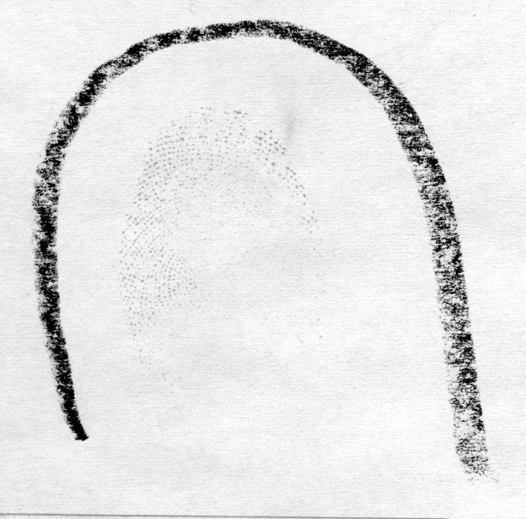
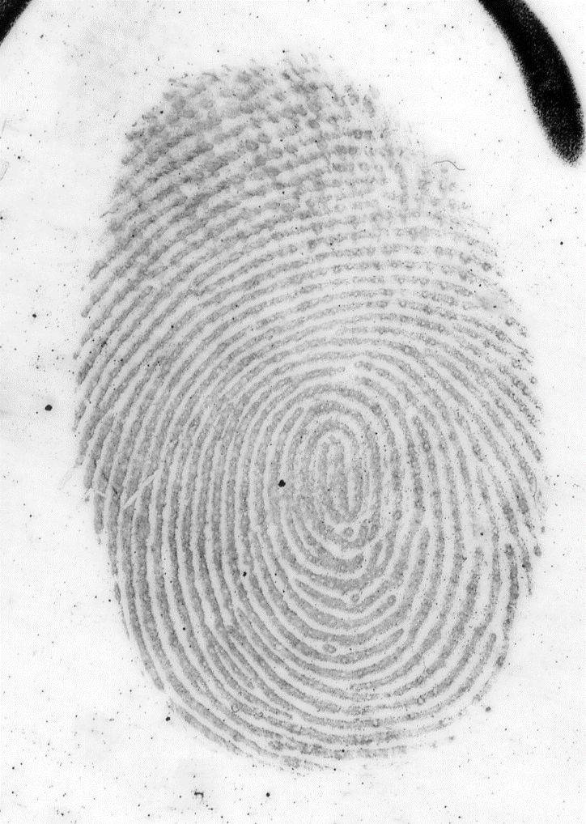
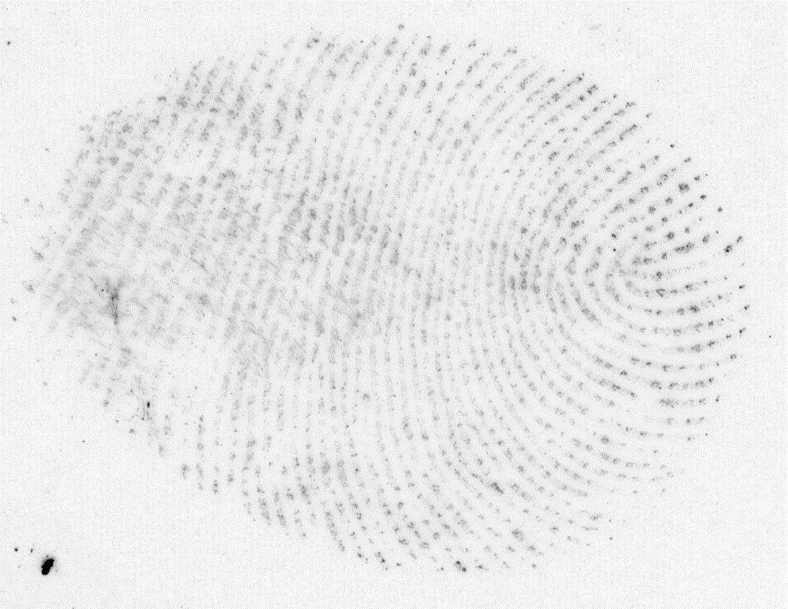
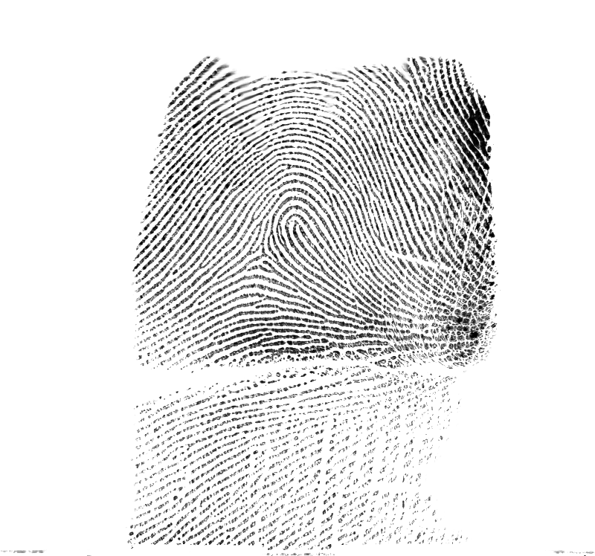
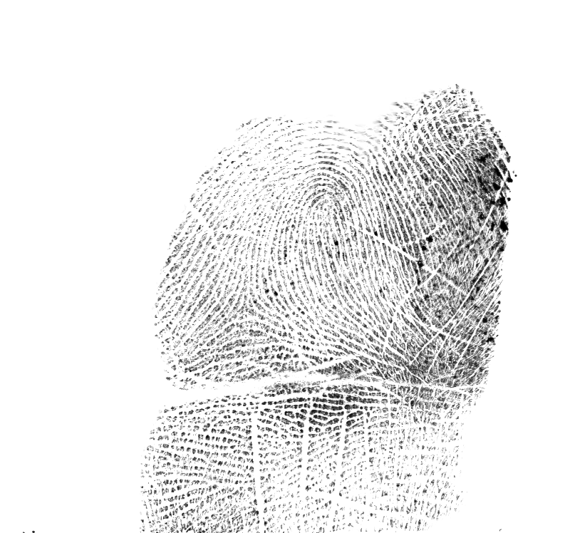
Sample Images
CVIP 2020
Bad - Latent Image
Good - Latent Image
Ugly-Latent Image
Rolled print
Rolled print

Slide 7
Latent fingerprint identification software
CVIP 2020
The results were obtained using a fully automated ,end to end latent fingerprint search system.
First the algorithm executes automated region of interest cropping.
Then the image is preprocessed for feature extraction and template generation.
Two separate minutiae extraction models provide complementary minutiae templates.
Finally, three minutiae templates and one texture template is generated.

Slide 8
Match scores
CVIP 2020
Two matchers are used for comparison between the query latent and the reference print.
They are the minutiae template matcher, and the other is the texture template matcher.
The latent minutiae templates, latent texture template generated are compared to the reference minutiae template and texture template.
Finally, the four comparison scores obtained are fused together to generate the final score.

Slide 9
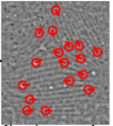
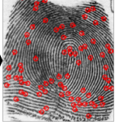
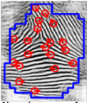
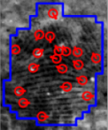
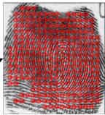
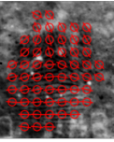
Latent to Reference Print Templates Comparison
CVIP 2020
Score 1
Minutiae template 1
Score 2
Score 3
Minutiae template
Minutiae template 2
Reference templates
Latent templates
Score 4
Texture template
Minutiae template 3
Texture template

Slide 10
Problem Statement
Show the impact of demographic biases in automated matching of latent fingerprints
Calculate error rates specific to the demographics of source subjects based covariate- specific ROC curves

Slide 11
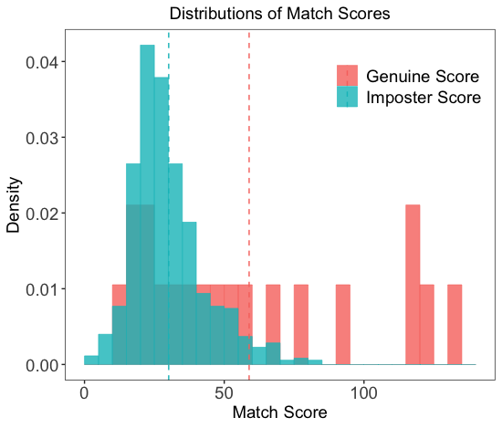
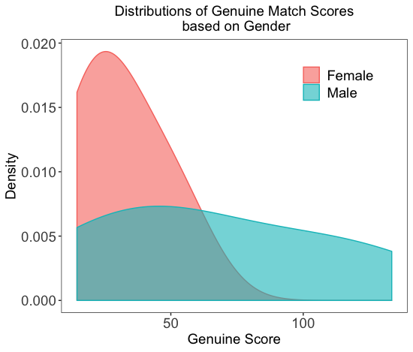
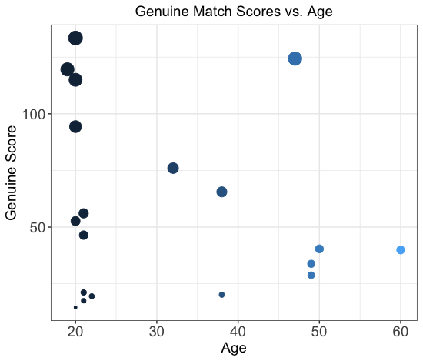
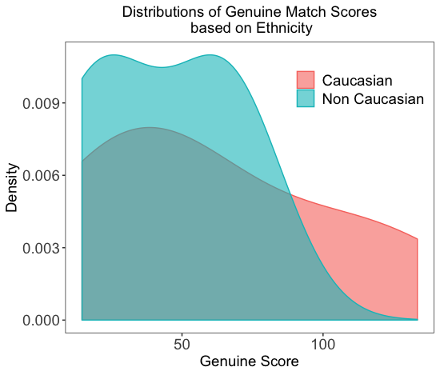
Experimental Setup
CVIP 2020
Fingerprint
FBI BioCoP Next Generation Identification Phase 1 (2008 - 2009)
Latent-to-reference print comparison
End-to-end latent fingerprint search system at Michigan State University
Covariate
Gender; age; ethnicity

Slide 12

Covariate-specific ROC curve Method
CVIP 2020
$$ROCx\left(u\right)=1−G1[{G0}^{−1}\left(1−u\right)\frac{σ0\left(x\right)}{σ1\left(x\right)}−\frac{μ1(x)−μ2(x)}{σ1(x)}]$$
𝑅𝑂𝐶_{𝑥(}𝑢)=1−𝐺₁[〖𝐺_{0〗^(}−1) (1−𝑢) 𝜎₀₍𝑥)/𝜎₁₍𝑥) −(𝜇₁(𝑥)−𝜇₂(𝑥))/(𝜎₁(𝑥))]
Covariate-specific ROC curve
Linear Regression

Slide 13
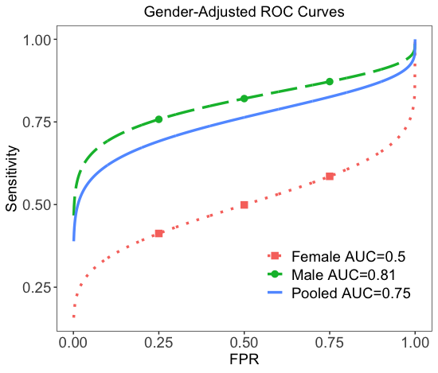
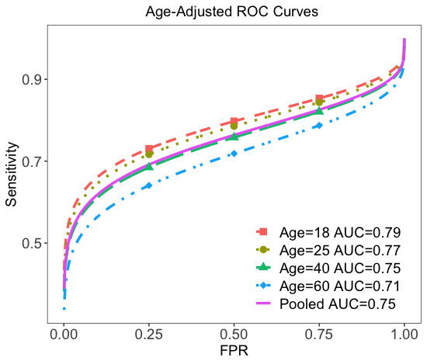
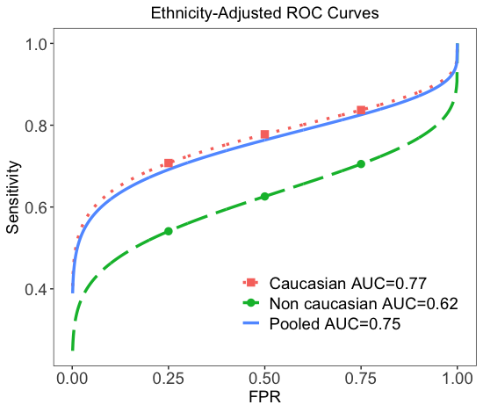
Univariate model results
CVIP 2020
In source identification problems
Gender: Model performs significantly better for male subjects
Age:
Model performance better for younger subjects.
Model performance is no significantly different for people at age=40 from pooled model
Ethnicity: Model performs better in Caucasian subjects than the Non-Caucasian ones

Slide 14
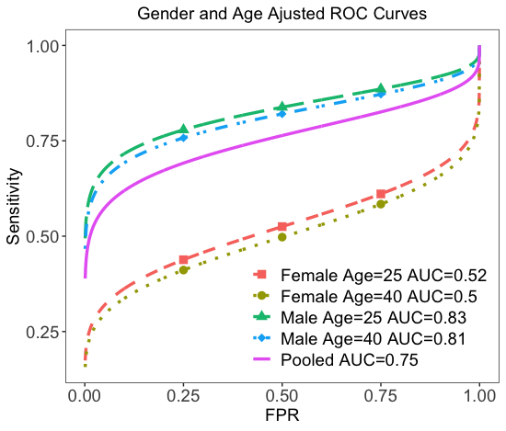
multivariate model results
CVIP 2020
Aggregated impact: same with univariate analysis
Model performs significantly better for male subjects
Model performance further slightly improved for younger subjects
Model performs better in Caucasian.

Slide 15
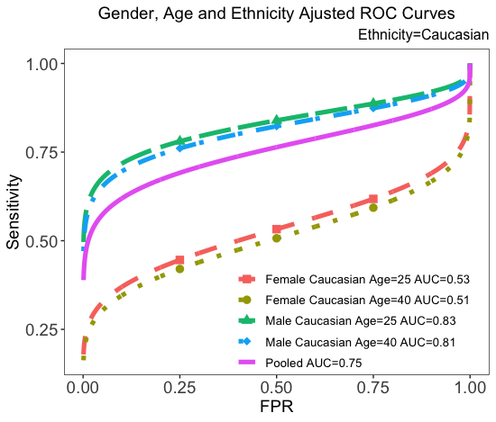
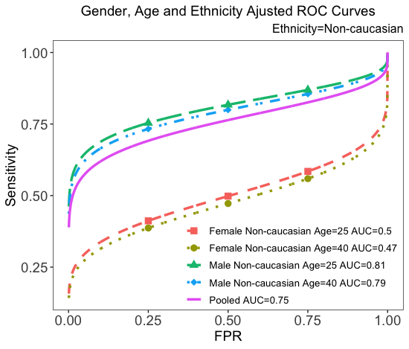
multivariate model results
CVIP 2020
Aggregated impact: same with univariate analysis
Model performs significantly better for male subjects
Model performance further slightly improved for younger subjects
Model performs better in Caucasian.

Slide 16
Conclusion
CVIP 2020
Impact of demographic information when using a fully automated end to end latent fingerprint search system.
The proposed approach is general and can also be extended to any biometric data.
We used a covariate specific ROC technique to interpret the error rate.
An inherent limitation is that ,assuming the availability of the covariates for each subject.
Further analysis will explore what might cause the demographic differentials analyzed in the proposed work

Slide 17
Acknowledgement
CVIP 2020
This work was partly supported in part by Award No. 2019-DU-BX-0011 awarded by the National Institute of Justice, Office of Justice Programs, US Department of Justice. The opinions, findings, and conclusions or recommendations expressed in this publication are those of the authors and do not necessarily reflect those of the US Department of Justice.

